Slide 1
Boost SAP Productivity with Azure OpenAI
Michael Mergell
November 2023

Slide 2

Our mission is to empower every person and every organization on the planet to achieve more.
SAP Teams will
- become more productive
- deliver better results
- provide faster solutions
- be more successful
- be happier
- …

Slide 3
Use cases
ChatGPT like experience in Teams
Ask anything privately and safely using your business data
OpenAI-Powered Bot for SAP Self-Services
Check User
Check Job Status
Communicate a Planned Maintenance
Add more SAP activities to help your SAP users …
Ask anything about (SAP) Data
Chat with your (SAP) documentation

Slide 4
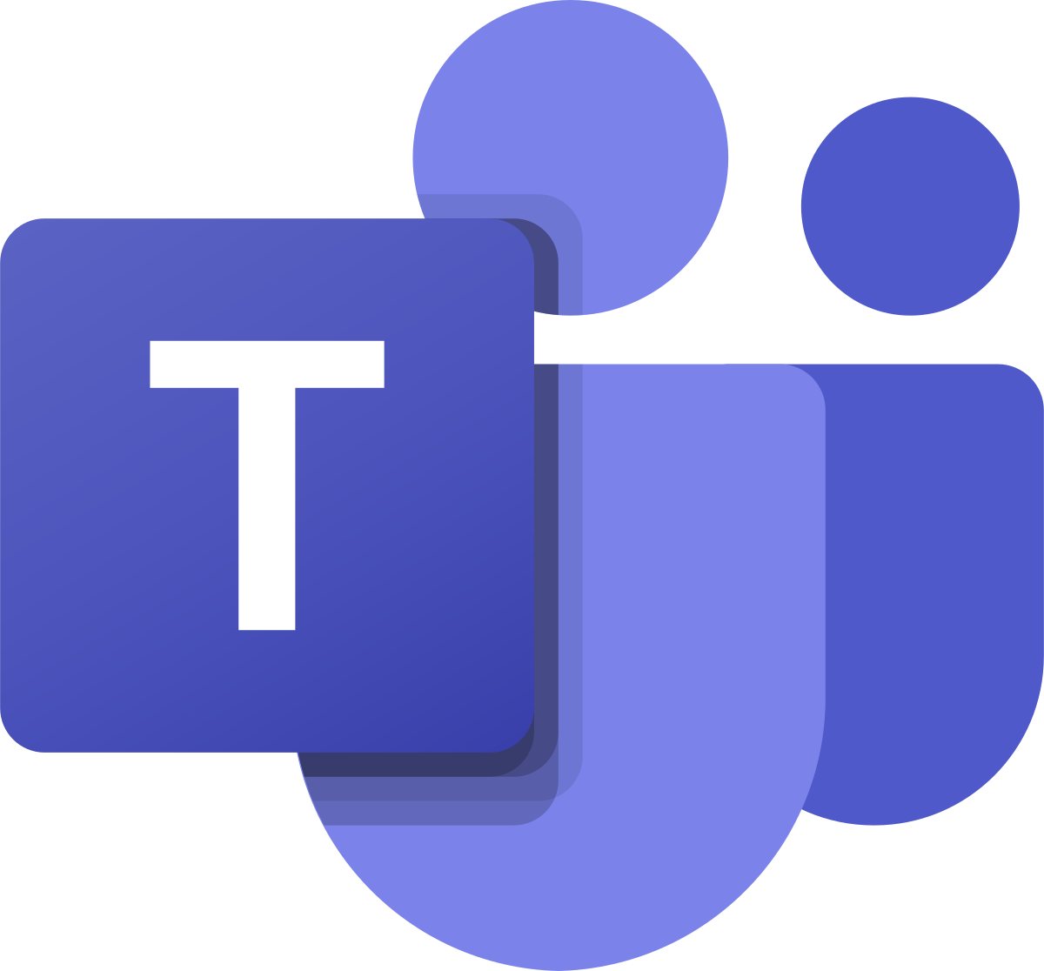




Azure OpenAI in Microsoft Teams Ask anything privately and safely using your business data
A user starts a conversation with the bot in Teams. He can paste business data and ask for review, summary, improving, etc.
The bot calls the Power Automate Flow
The Flow triggers OpenAI via the HTTP Connector
OpenAI responds to the request and the result is presented within Teams.
Teams
1
Power Automate
Flow
2
3
4
Power Virtual Agent
Chat Bot
HTTP
Connector
Azure Open AI
https://github.com/mimergel/Azure_OpenAi_Chat_in_Teams

Slide 5
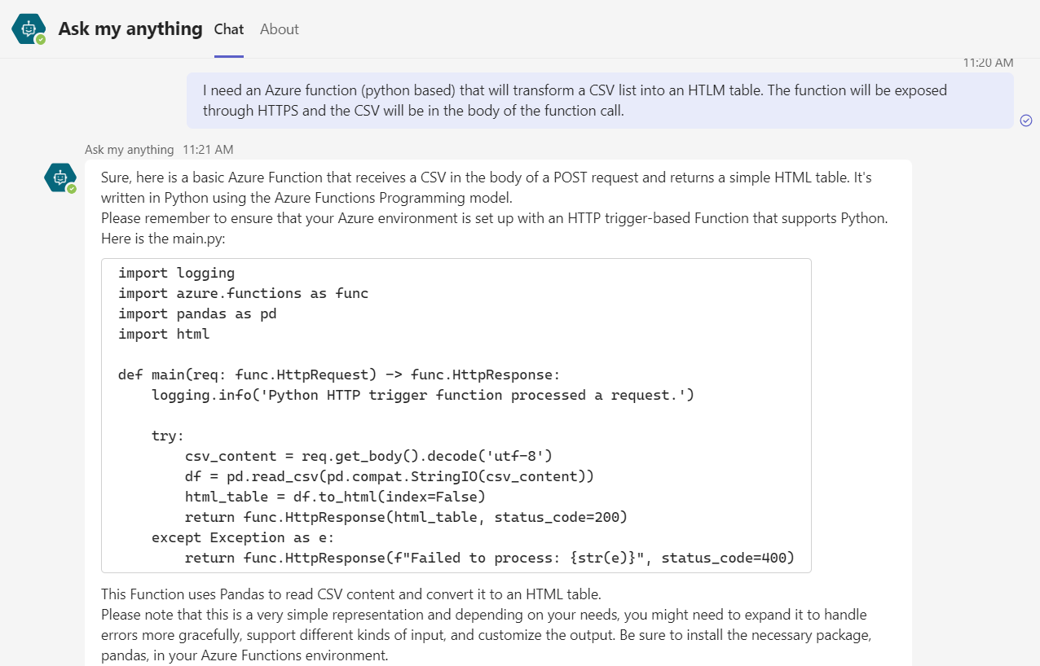
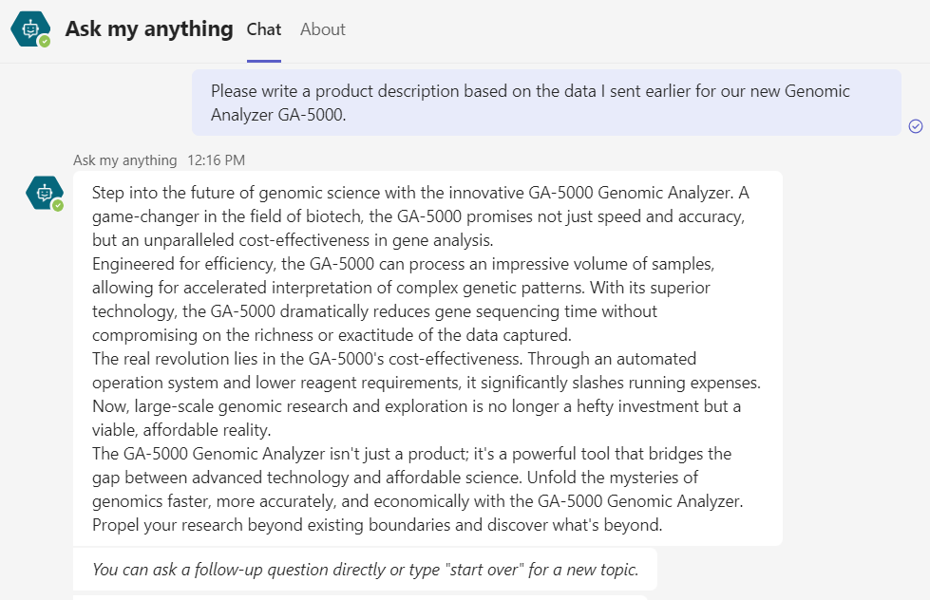
Examples

Slide 6






Azure OpenAI-powered Bot for SAP Self-Services
A user starts a conversation with the bot in Teams.
The bot calls the flow.
The flow triggers OpenAI via HTTP. The conversation continues until OpenAI knows the intended action and all related information.
Once confirmed, OpenAI sends a JSON message containing the action details. The flow then proceeds accordingly and triggers SAP and other connectors.
The SAP ERP Connector connects to SAP via the Data Gateway and starts the RFC BAPI in SAP.
5
4
SAP Connector
Teams
Azure Data
Gateway
M365 Connectors
1
Power Automate
Flow
2
3
Power Virtual Agent
Chat Bot
HTTP
Connector
Azure Open AI
https://github.com/mimergel/Azure_OpenAI_powered_SAP-Self-Services

Slide 7
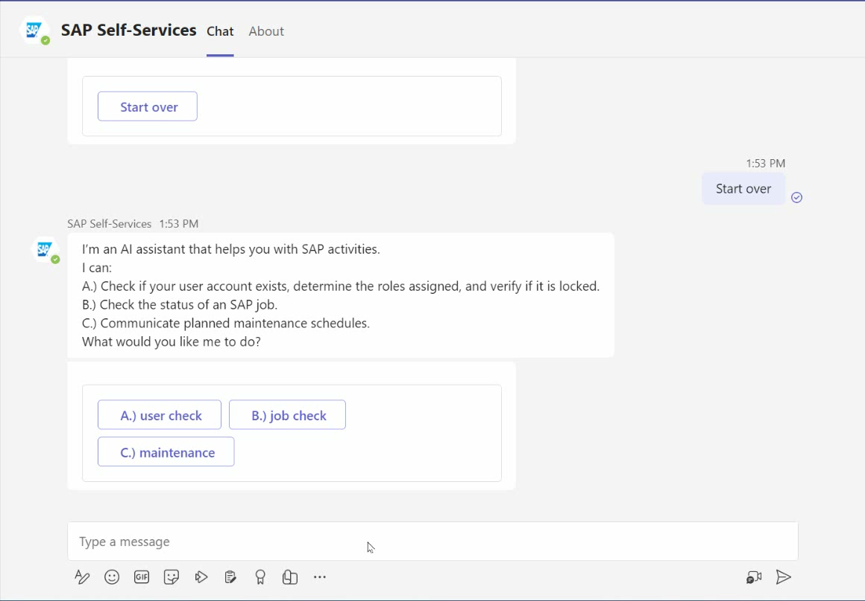
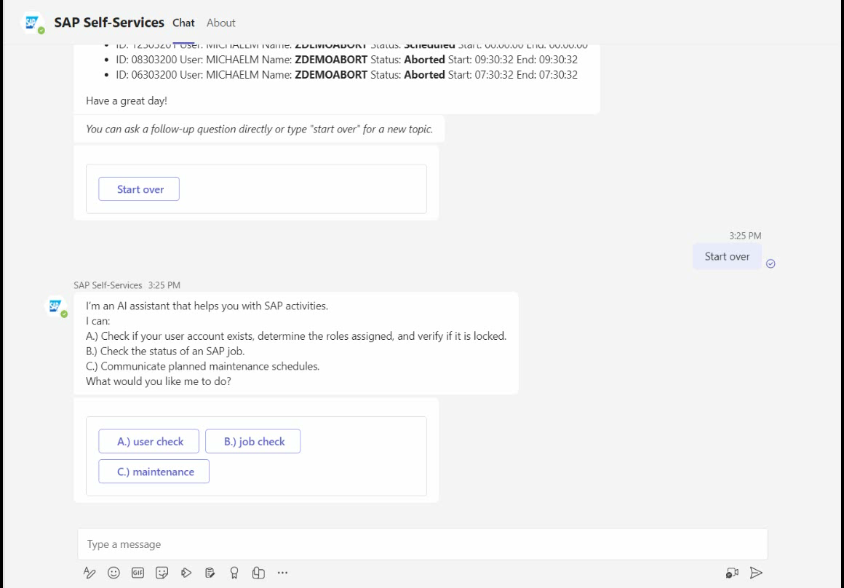
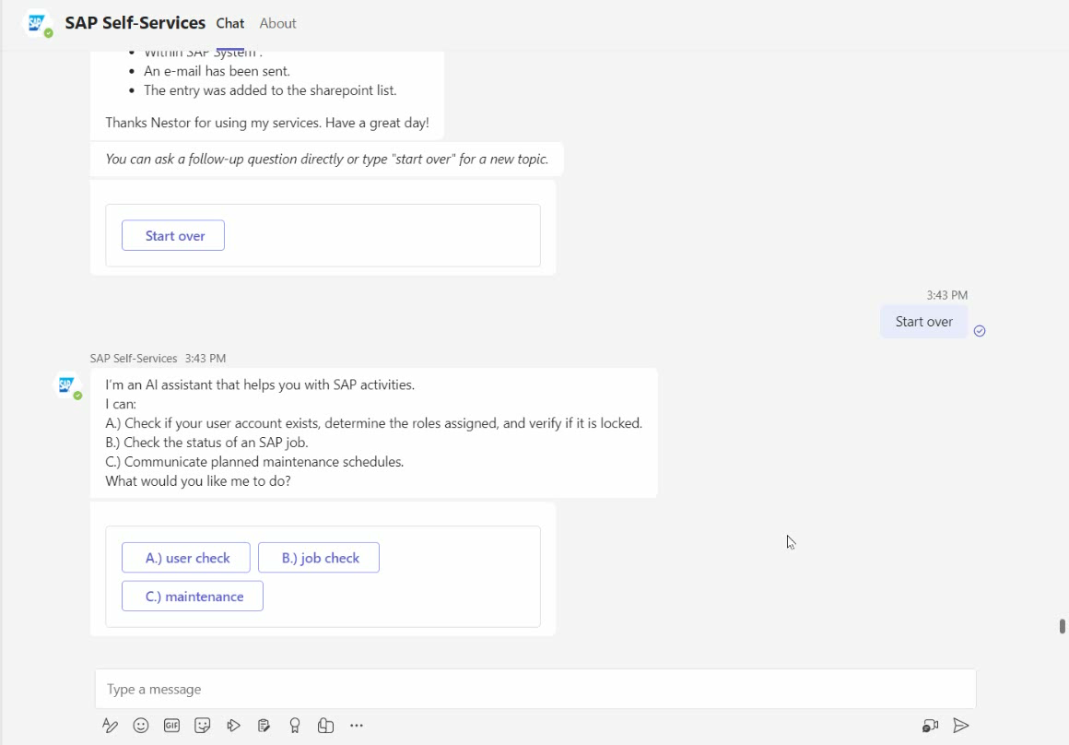
Demo
SAP User Check
SAP Job Status Check
Communicate a planned maintenance

Slide 8

Ask anything about SAP data or any DB
A user starts a conversation with the bot in Teams.
The PVA bot calls the flow
The flow runs a HTTP action that calls Open AI chat
Open AI gets the question, with instructions including the DB schema and returns the SQL command along with explanations
The Flow triggers via another HTTP connector a Function App with the SQL as parameter
The Function App runs the SQL directly on the HANA DB and the results is pushed to Teams as adaptive card
6
5
Teams
HTTP
Connector
Function App
1
Power Automate
Flow
2
3
4
Power Virtual Agent
Chat Bot
HTTP
Connector
Azure Open AI
https://github.com/mimergel/chat_with_your_sap_data

Slide 9
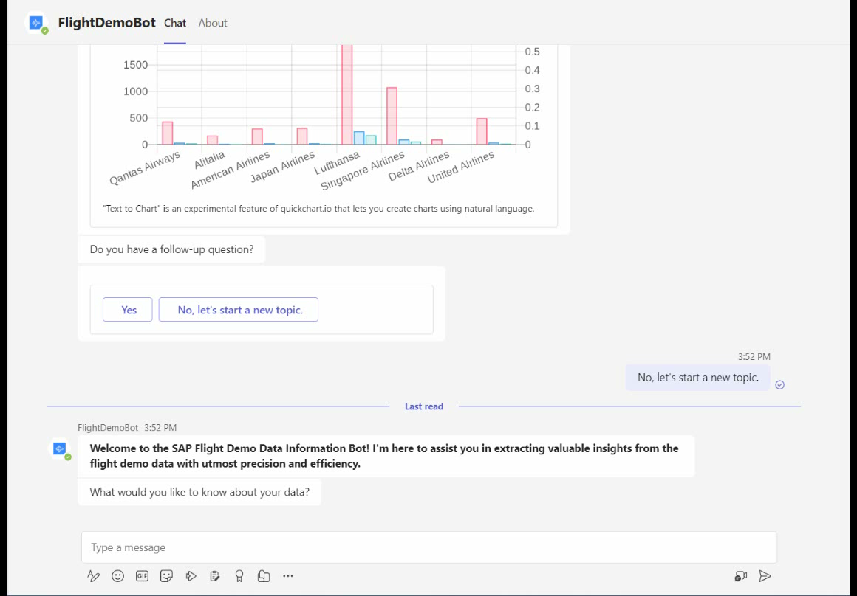
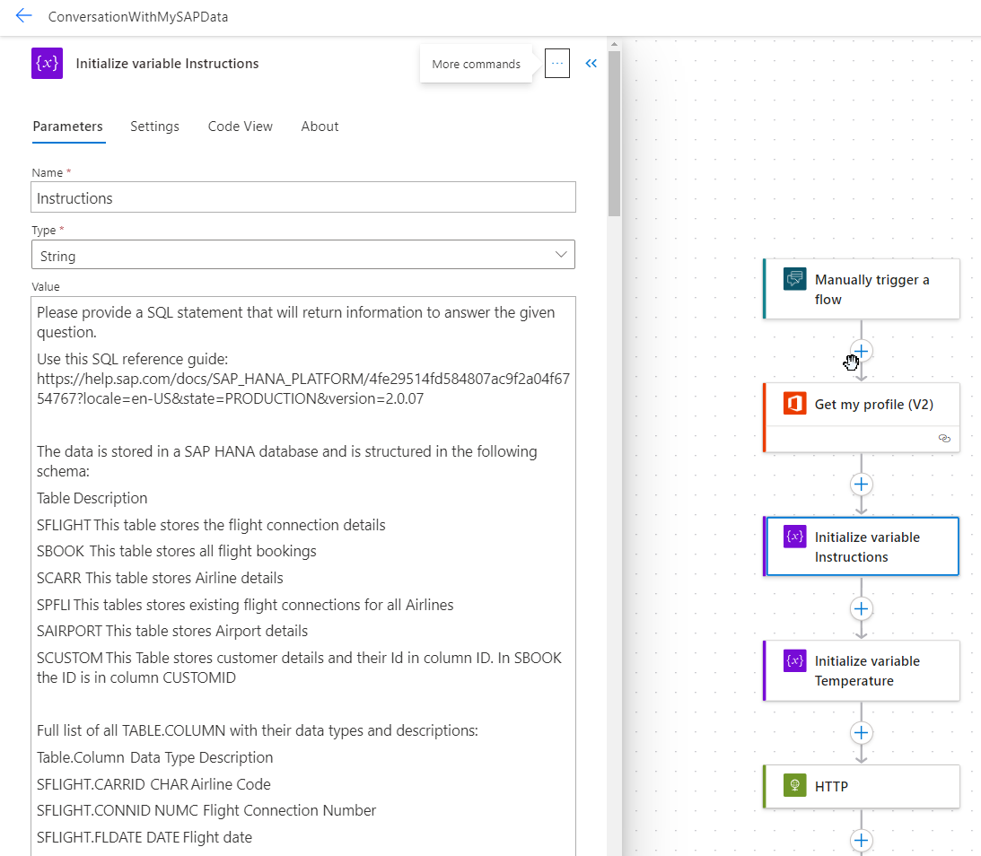
Demo

Slide 10
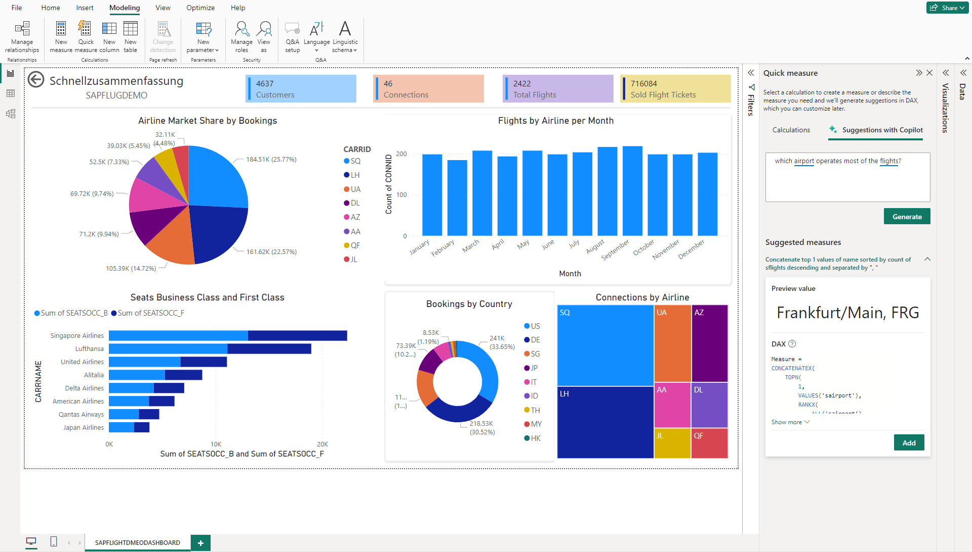
Chat with your data in PowerBI

Slide 11
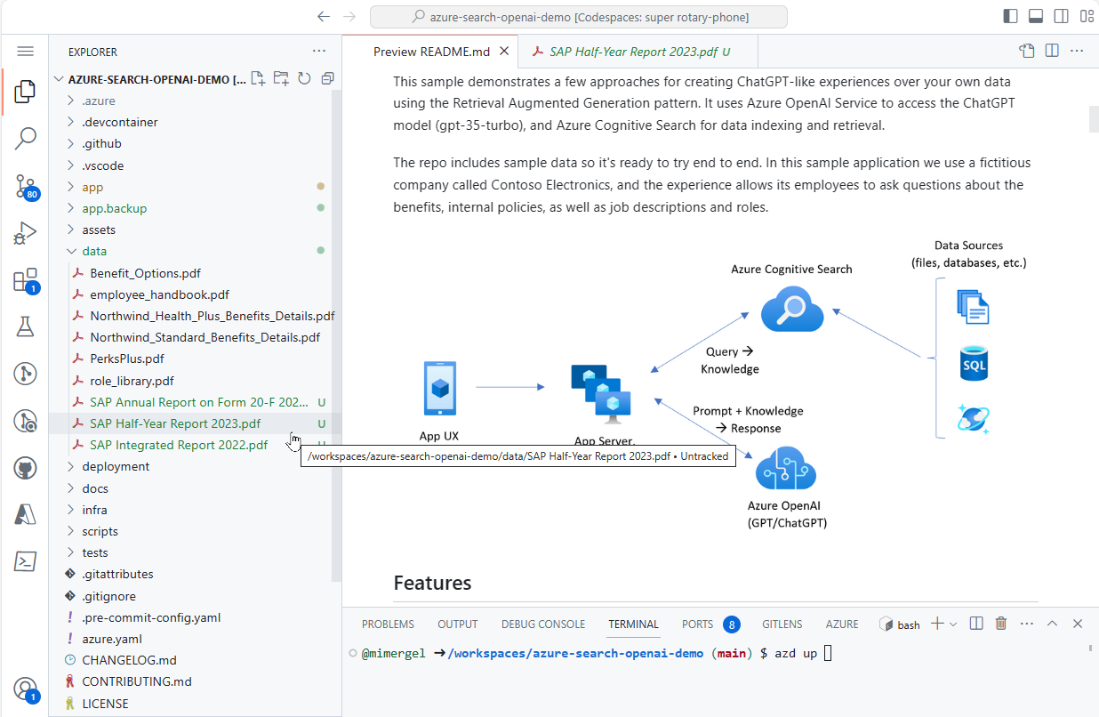
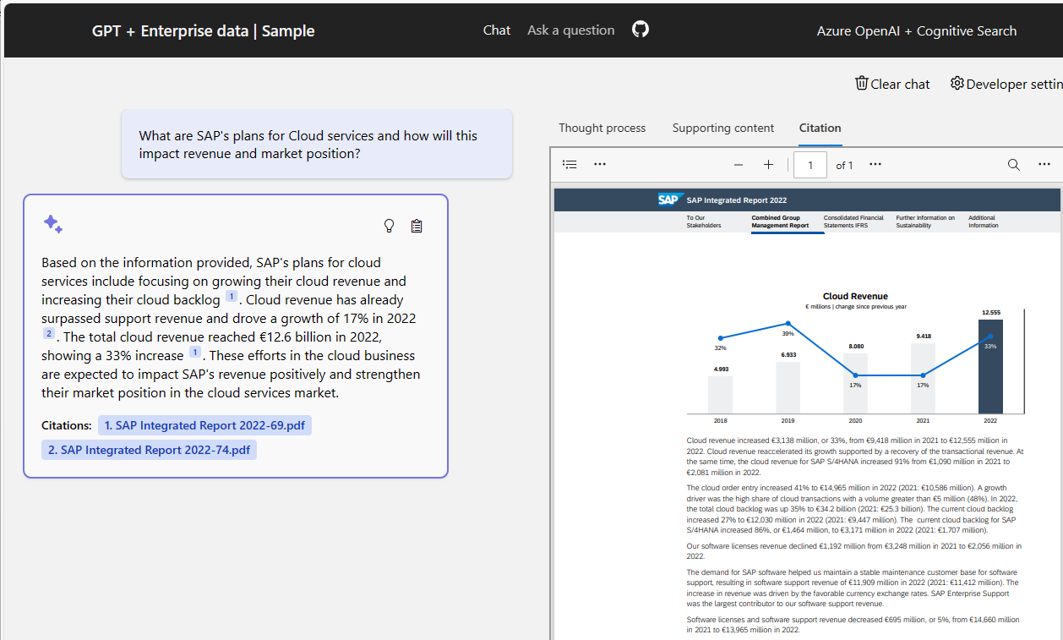
Chat with your Documentation using Azure OpenAI and Cognitive Search https://github.com/Azure-Samples/azure-search-openai-demo

Slide 12
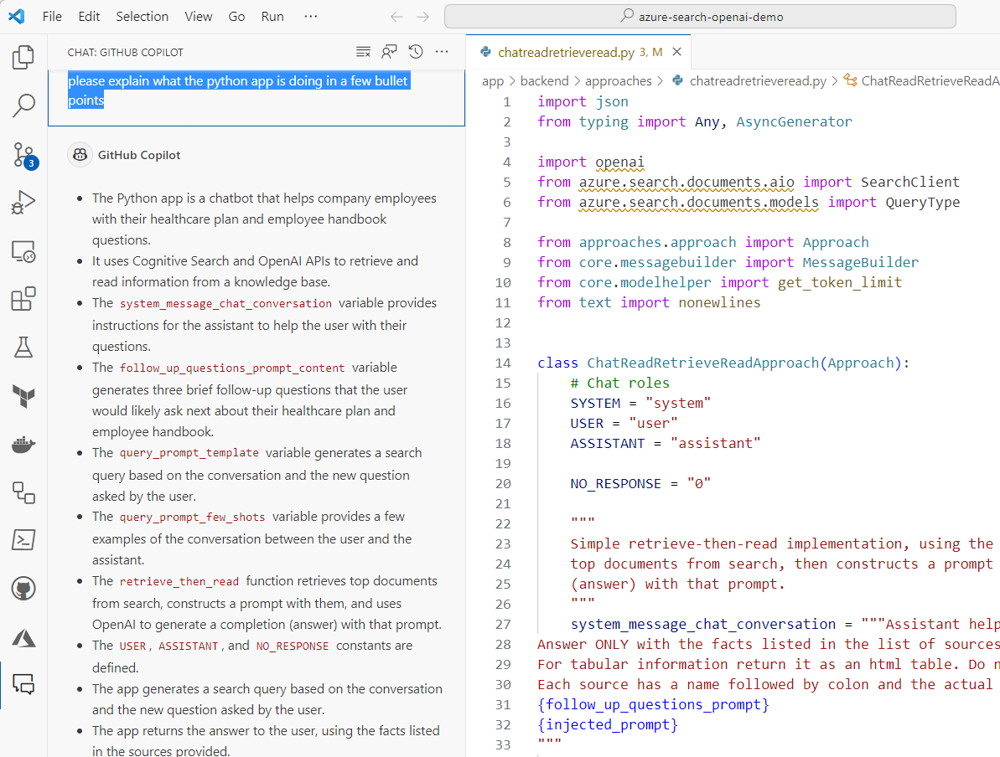
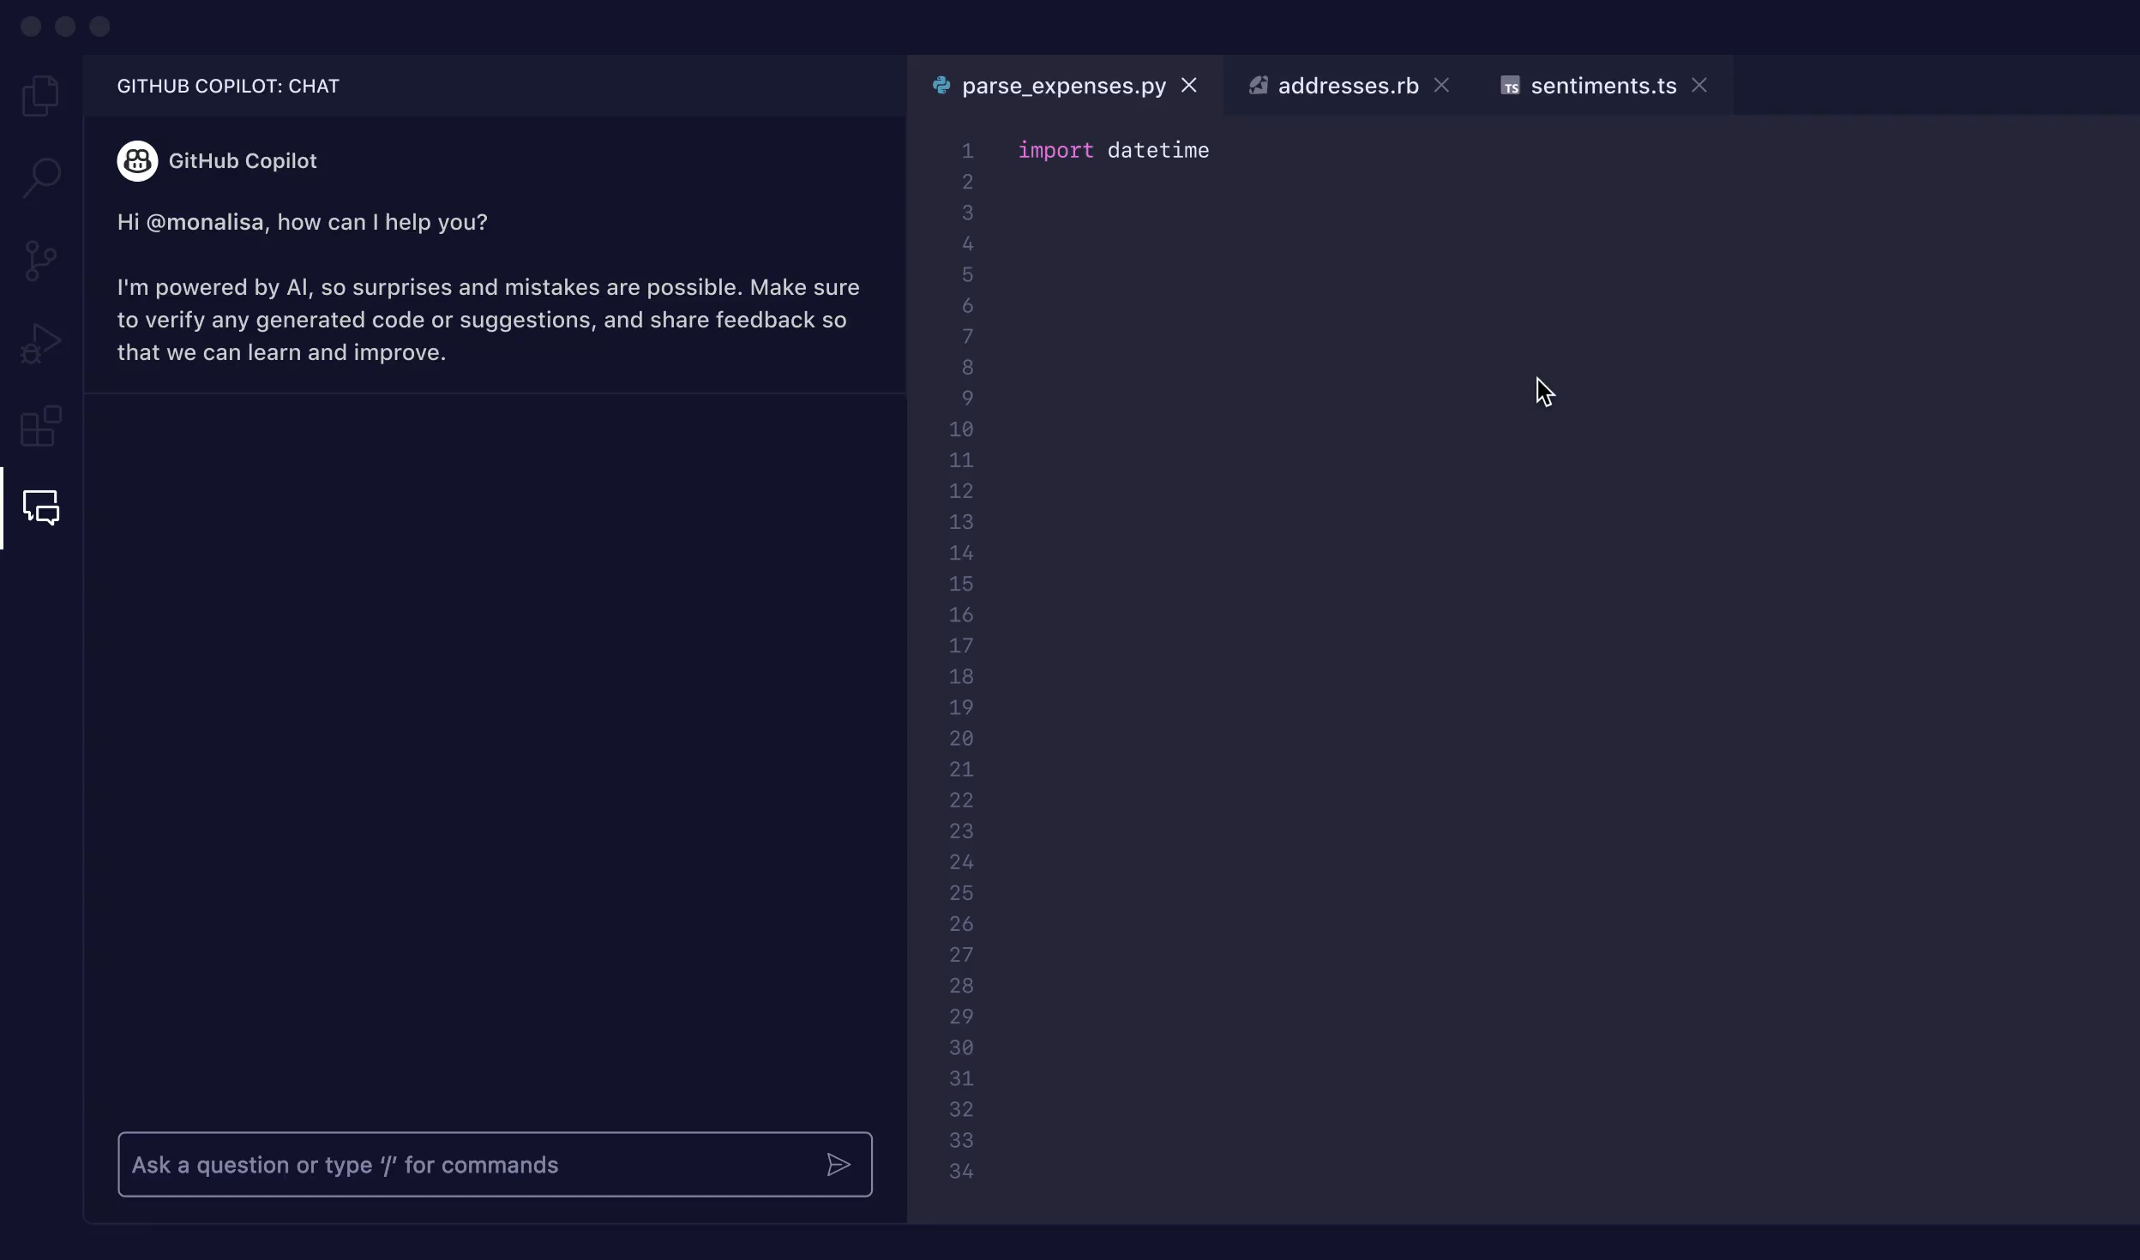
GitHub Copilot
Context-Aware
Code Suggestions
Multiple Languages
Learning from Comments
Powered by OpenAI's Codex
Code Explanations

Slide 13
Final slide with logo

